Slide 1
Lead Scoring Case Study
SUBMITTED BY :
Argha Chakraborty
Ayush Saraswat
Madhur

Slide 2









Contents
◆ Problem statement
◆ Problem approach
◆ EDA
◆ Correlations
◆ Model Evaluation
◆ Observations
◆ Conclusion

Slide 3









Problem Statement
◆ An education company named X Education sells online courses to industry professionals.
On any given day, many professionals who are interested in the courses land on their website and browse for courses. They have process of form filling on their website after which the company that individual as a lead.
◆ Once these leads are acquired, employees from the sales team start making calls, writing emails, etc.Through this process, some of the leads get converted while most do not.
◆ The typical lead conversion rate at X education is around 30%. Now, this means if, say, they acquire 100 leads in a day, only about 30 of them are converted. To make this process more efficient, the company wishes to identify the most potential leads, also known as Hot Leads.
◆ If they successfully identify this set of leads, the lead conversion rate should go up as the sales team will now be focusing more on communicating with the potential leads rather than making calls to everyone

Slide 4









Business Objective
◆ Lead X wants us to build a model to give every lead a lead score between 0 -100 . So that they can identify the Hot leads and increase their conversion rate as well.
◆ The CEO want to achieve a lead conversion rate of 80%.
◆ They want the model to be able to handle future constraints as well like Peak time actions required, how to utilize full man power and after achieving target what should be the approaches.

Slide 5
◆ Importing the data and inspecting the data frame
◆ Data preparation
◆ EDA
◆ Dummy variable creation
◆ Test-Train split
◆ Feature scaling
◆ Correlations
◆ Model Building (RFE Rsquared VIF and p- values)
◆ Model Evaluation
◆ Making predictions on test set
Problem Approach

Slide 6


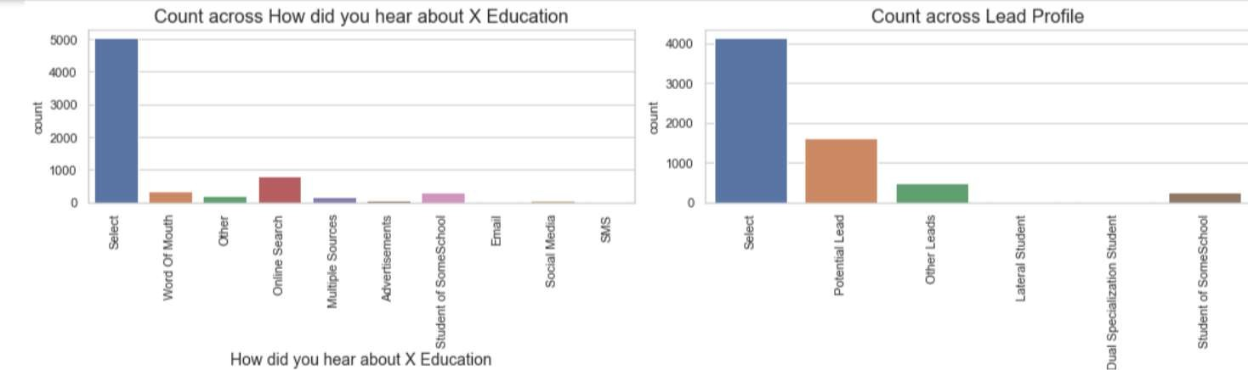





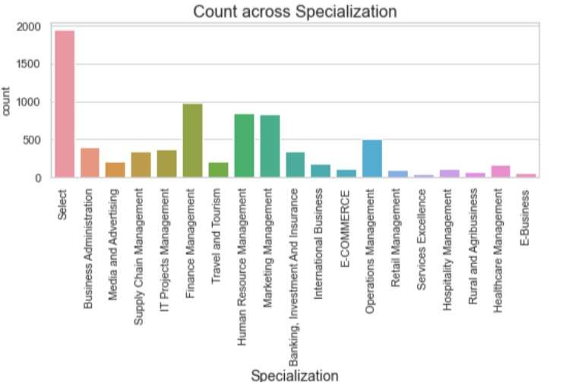


EDA – Data Cleaning
◆ There are a few columns in which there is a level called 'Select' which is taking care

Slide 7




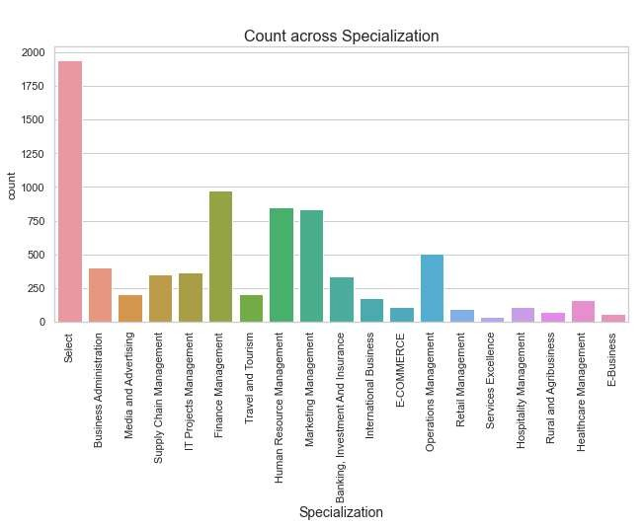





Specialization
Leads from HR, Finance & Marketing management specializations are high probability to convert

Slide 8



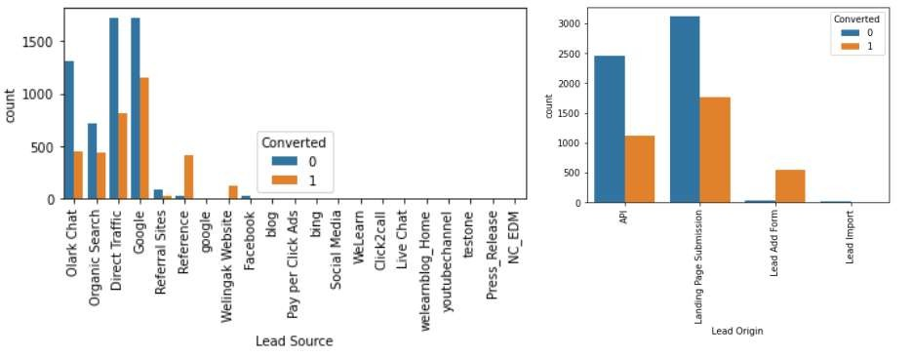






Lead Source & Lead origin
In lead source the leads through google & direct traffic high probability to convert
Whereas in Lead origin most number of leads are landing on submission

Slide 9


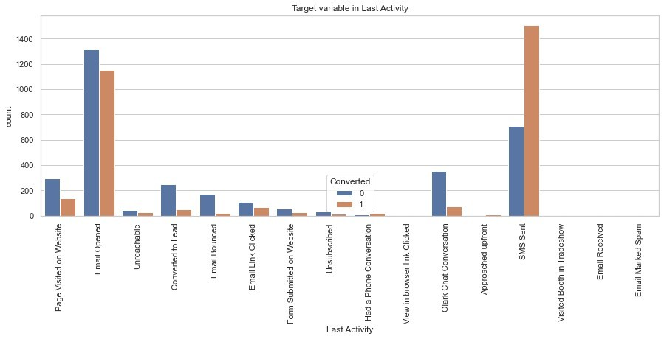







Last lead Activity
Leads which are opening email have high probability to convert, Same as Sending SMS will also benefit.

Slide 10


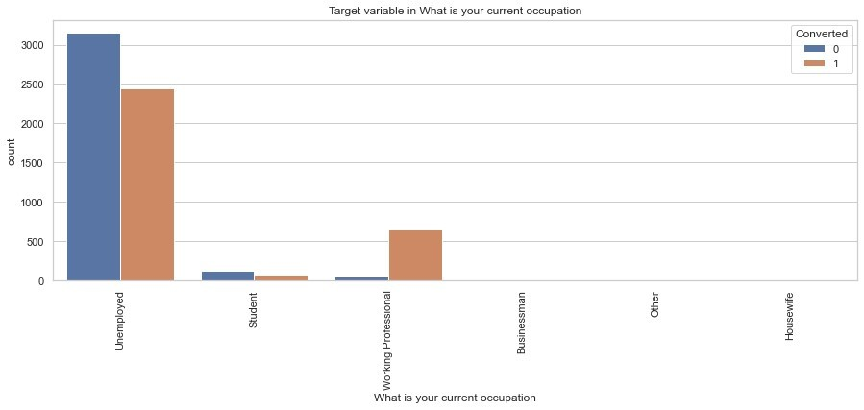







Last What is Your Occupation
Leads which are Unemployed are more interested to join the course than others.

Slide 11


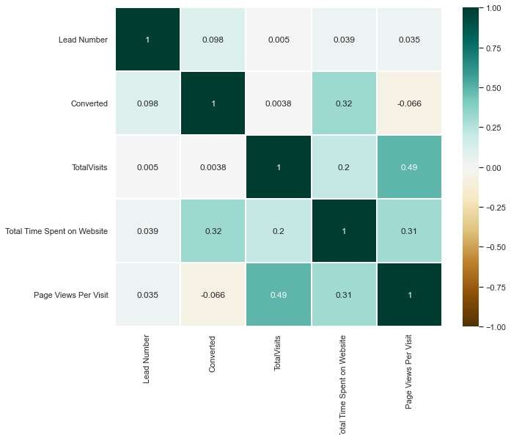







Correlation
There is no correlation between the variables

Slide 12





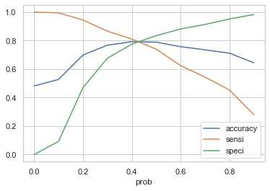
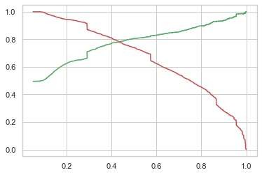




Model Evaluation
ROC curve
0.42 is the tradeoff between Precision and Recall -
Thus we can safely choose to consider any Prospect Lead with Conversion Probability higher than 42 % to be a hot Lead

Slide 13









Observations
Train Data:
Accuracy : 80%
Sensitivity : 77%
Specificity : 80%
Final Features list:
◆ Lead Source_Olark Chat
◆ Specialization_Others
◆ Lead Origin_Lead Add Form
◆ Lead Source_Welingak Website
◆ Total Time Spent on Website
◆ Lead Origin_Landing Page Submission
◆ What is your current occupation_Working Professionals
◆ Do Not Email
Test Data:
Accuracy : 80%
Sensitivity : 77%
Specificity : 80%

Slide 14









Conclusion
The conversion rate for API and Landing Page Submission leads is around 30-35%, which is close to the average. However, the conversion rate is significantly lower for Lead Add Form and Lead Import. This suggests that more attention should be given to leads originating from API and Landing Page Submission to improve overall conversion rates.
The majority of leads are generated through Google and Direct Traffic, but the highest conversion rates are observed for leads coming from Referrals and Welingak Website.
Leads who spend more time on the website are more likely to convert, indicating that website engagement is a strong predictor of lead conversion.
The most common last activity recorded is email opened, while the highest conversion rate is seen for leads who received SMS Sent. Additionally, the majority of leads are unemployed, but the highest conversion rate is among working professionals.

